Slide 1
Neighborhood Rating System in Guadalajara
Alejandro salvador Orozco guevara

Slide 2
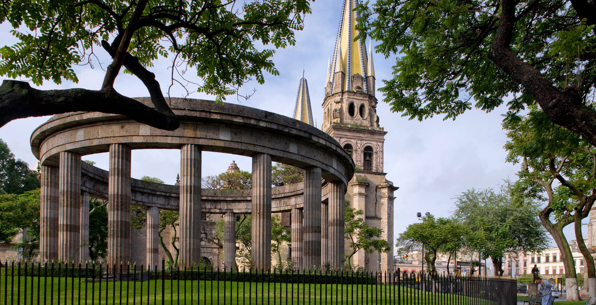
Introduction
Guadalajara is the second most important city in Mexico, and is famous for tequila and mariachi music.

Slide 3
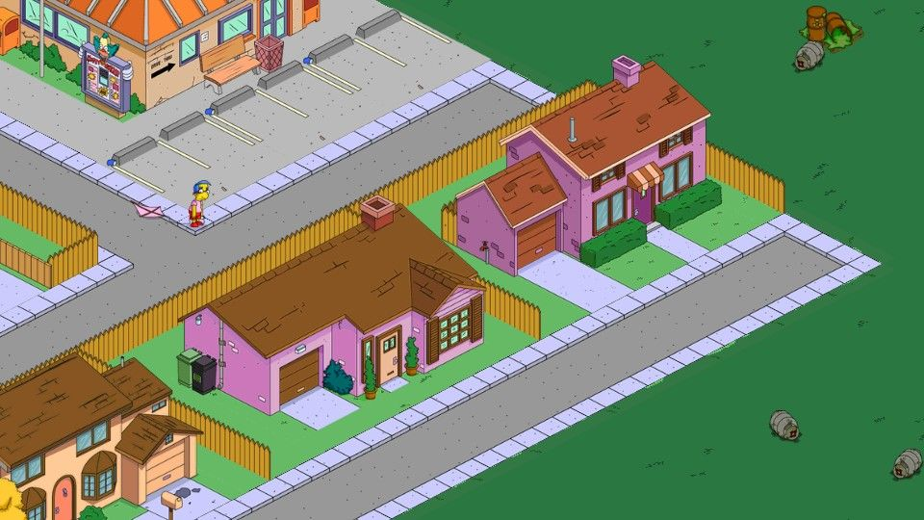
Introduction
My project is to rate their different neighborhoods based on my criteria, so that a person interested in moving to Guadalajara receives some guidance on the best neighborhoods.

Slide 4
Data
The names of the neighborhoods of Guadalajara, as well as their coordinates, are obtained from the following source: https://datos.gob.mx/busca/dataset/colonias/resource/7a04858f-da5f-45b8-88bb-ffff7c6ae17e, a repository of official data of the Mexican government.

Slide 5

Methodology
A dataset will be obtained with different venues as features and the number of occurrences as values, and neighborhoods as indexes. Then I will rate some neighborhoods I know with one, two, three, four or five stars, depending on how good the neighborhood considers. A classification model (SVM) will be trained with that dataset, and will be used to rate the rest of the neighborhoods, which I do not know and cannot qualify a priori.

Slide 6

Support-Vector Machine
In machine learning, support-vector machines (SVMs, also support-vector networks) are supervised learning models with associated learning algorithms that analyze data used for classification and regression analysis.

Slide 7
Conclusion
Machine learning can be used to decipher patterns in the way we make decisions. The way I rated the neighborhoods was completely intuitive, discretionary; However, I suppose there is a correlation between the number of elements in each category of place and the qualification I granted. A neighborhood full of places that I like will imply a better rating from me. This can be extrapolated to any other user who qualifies a subset of neighborhoods, the algorithm must be able to find the relationship between the subject's decision and the characteristics discussed.

Slide 8
Thank you!

